Slide 1


Score Clinical Patient Notes presentation
By: Angela donguia

Slide 2
Overview
This notebook is used to find out the following:
Analyzing the dataset to find out basic information of the CSV files
Listing out Sample notes and their corresponding labels with locations
Visualizing the data for patients and their distribution
Finding out the list of all annotations in the dataset

Slide 3
Summary of Work Done
The main goal was to find how doctors can easily find out the symptoms of the patients through the use of this notebook and spacy can be used to mark up the annotations with accuracy, such that the doctors don't need to manually annotate the data.

Slide 4
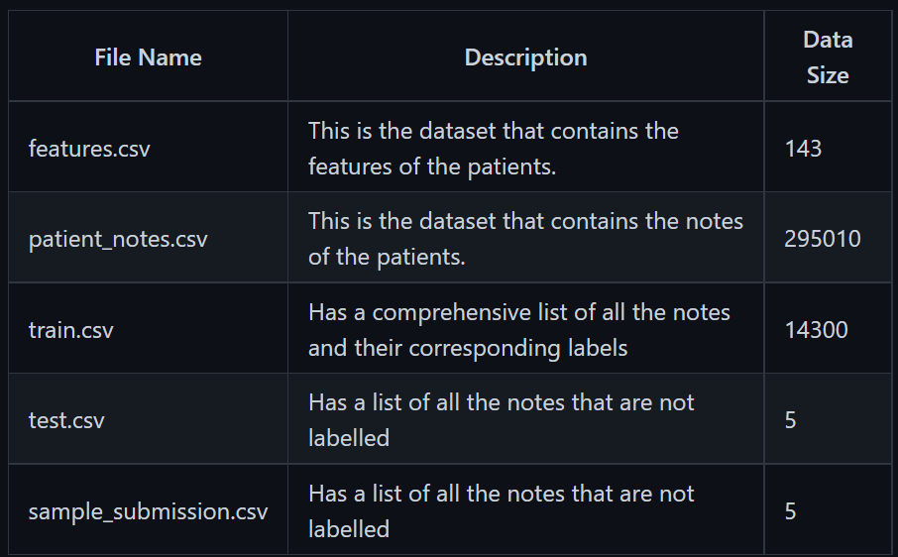
Data Input files that are used to find and analyse the data includes:

Slide 5
Preprocessing / Clean up Data Visualization
Since there was no missing values in the dataset, no cleaning was required.
Data Visualization
For Data Visualization, SNS was used to plot the following:
Patient Notes Distribution (Per case)
Patient Notes Length Distribution
Feature Distribution (per Case)
Feature Length Distribution
Graphing Annotations Distribution
Annotation Length Distribution

Slide 6
Problem Formulation
At first step, we firstly inputted all the csv files to have basic information about the dataset.
Soon after that, we visualized the data so we can see the frequency of each annotation and how each annotation varies.
Such as, how many patients have the annotation, what is the length, are there multiple annotations, etc.
Later on, we started to find out about how the annotation and patient history looks like so we can better understand the data.
With the previous step out of the way, we visualized all the annotations and their corresponding labels to find frequency and distribution and get the length of distribution.
In the end, we highlighted the annotations using Spacy

Slide 7
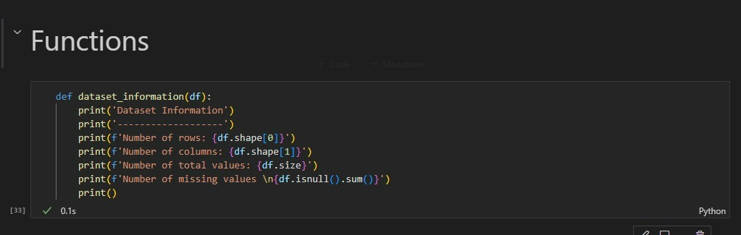
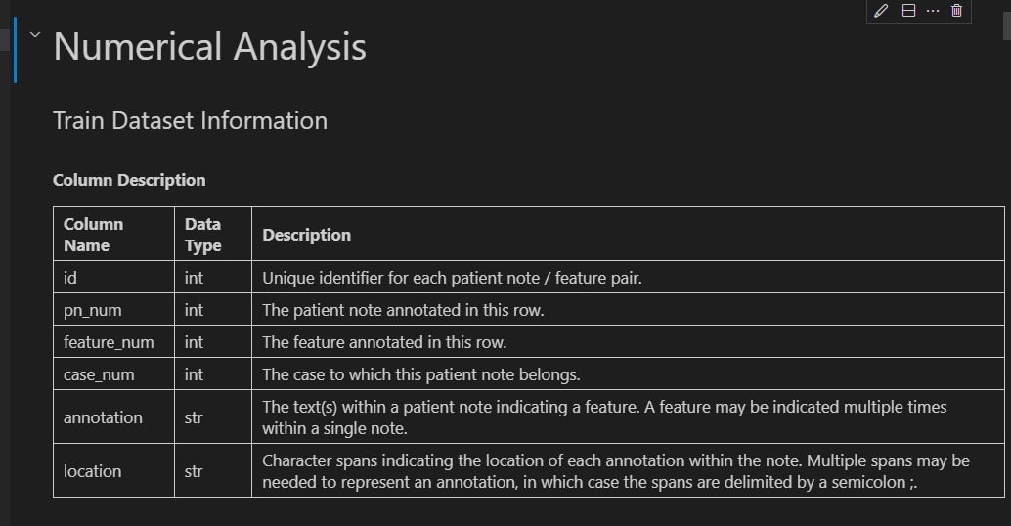
functions
I have only used one function to get information out of the dataset
things like - rows- columns- are there any missing values- the total amount of rows
then we get to numerical analysis part, where we describe information of our datasets
note, there are 5 csv files so we will first check each of them

Slide 8
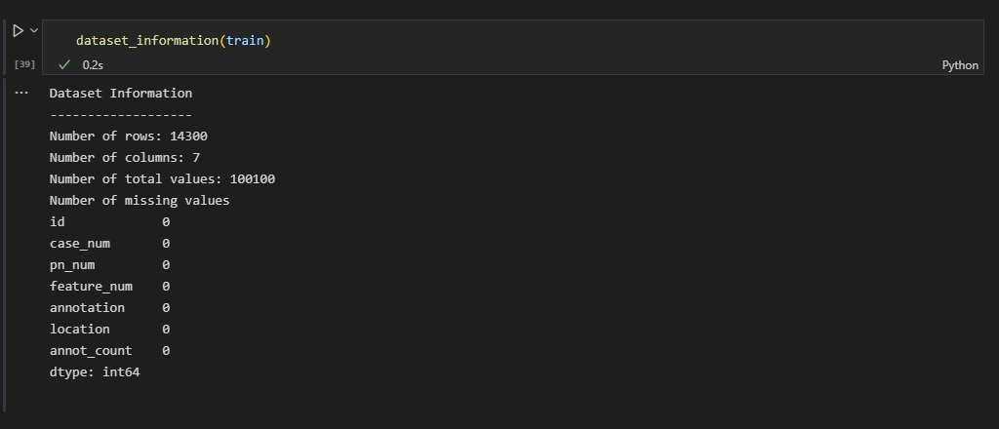
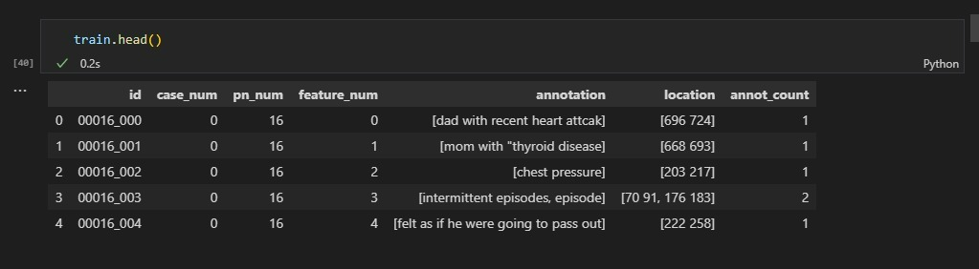
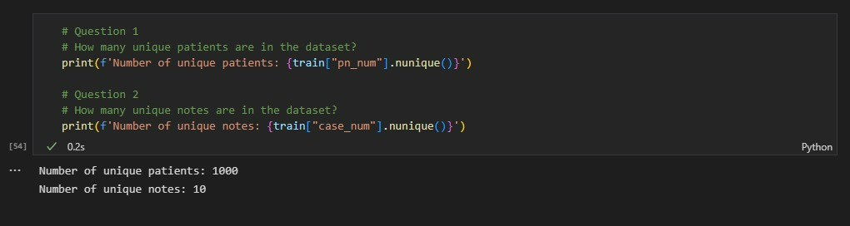
Train.csv We firstly found about the initial information about our dataset
We then looked at a bit overview of how it looks like
Then we asked some basic questions to ourselves (to make things interesting)

Slide 9
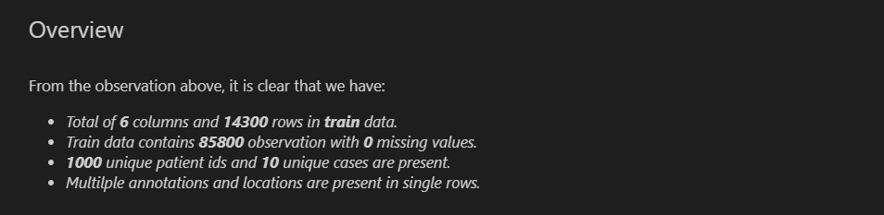
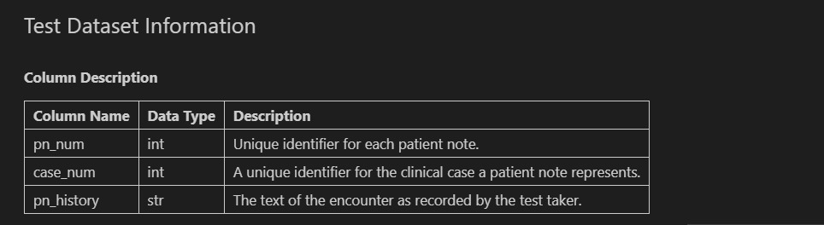
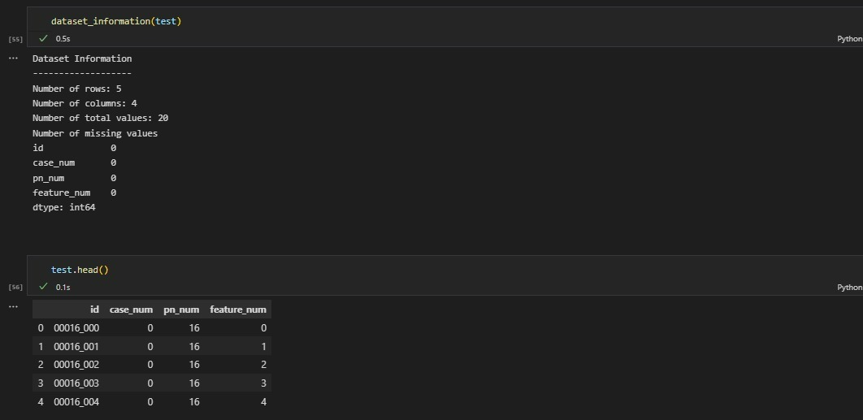
Lastly, we summarize the findings of train.csv file
test.csv We firstly showed the table of what columns are present in train dataset
Then we saw some basic information of it and looked at how data looked in it

Slide 10
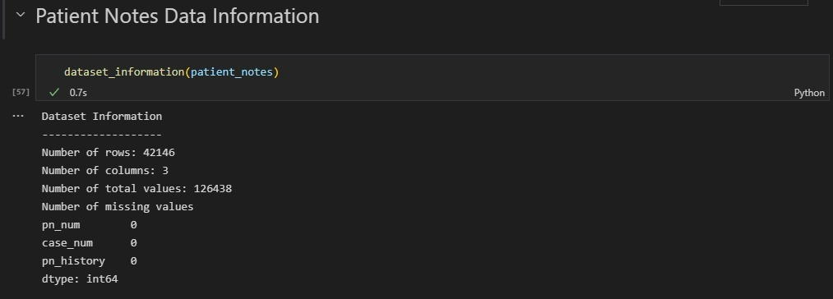
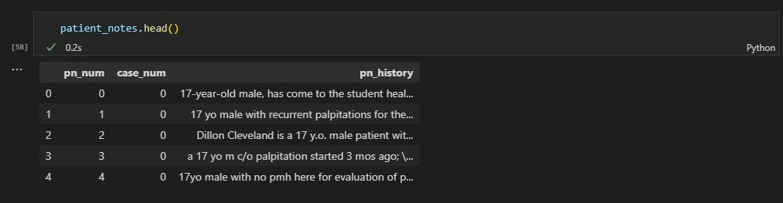
We firstly found out the basic information of Patient Notes
Then what is present inside of it

Slide 11
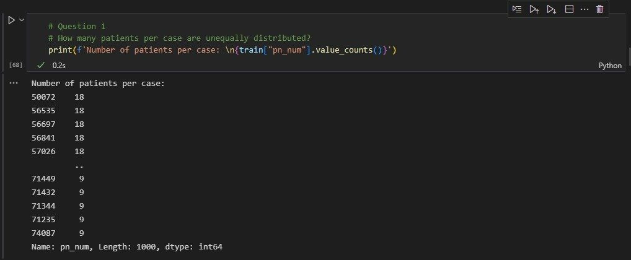
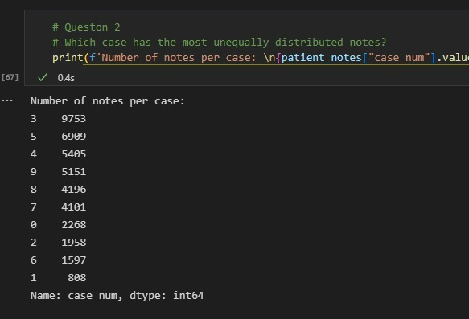
Soon after that, there are a few questions that arises Then we list our findings of Patient notes, in a summery

Slide 12
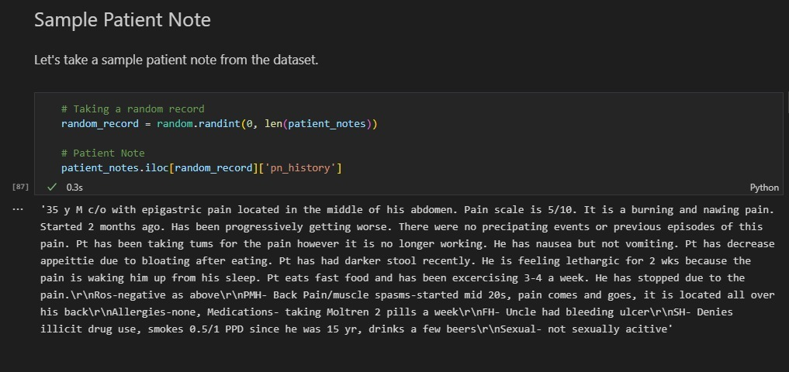
Another question includes, how does this patient note looks like So we took a sample patient note

Slide 13
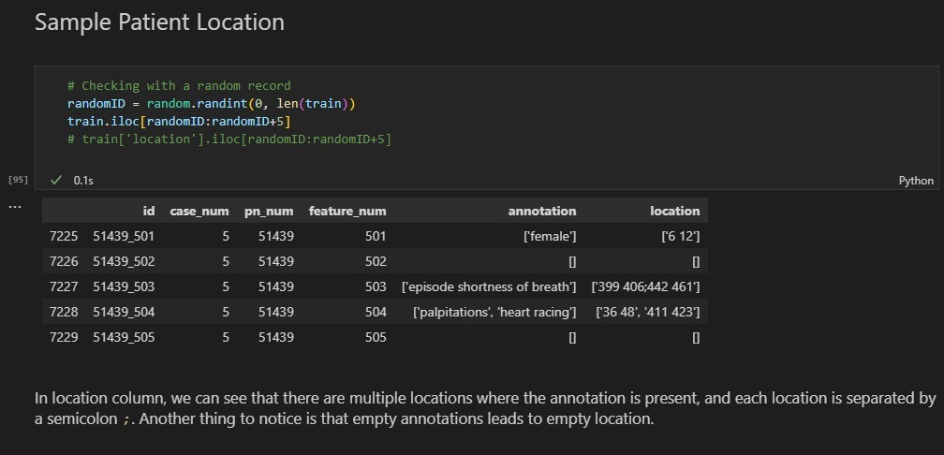
Now from above, we mentioned there are multiple patient locations, was that true? Let's check that out: We used iloc to filter some values from our dataset and we listed 5 random values

